Slide 1
Introduction to Statistics for Ecology and Evolutionary Biology Columbia University, Fall 2021
Welcome!

Slide 2
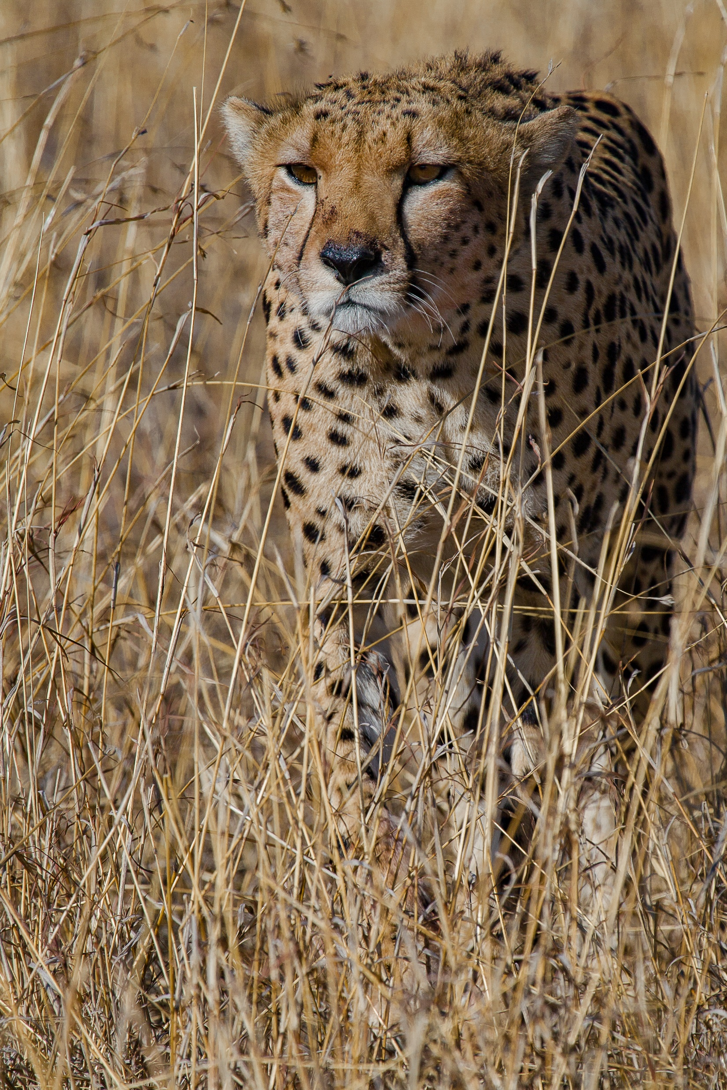
About me
Dr. Steffen Foerster
Director, Data Team, Bureau of Division Management and Systems Coordination, Division of Disease Control, NYC Department of Health and Mental Hygiene
Lecturer, Department of Ecology, Evolution and Environmental Biology, Columbia University
Research Affiliate, Jane Goodall Research Institute, Department of Evolutionary Anthropology, Duke University
Freelance wildlife photographer

Slide 3
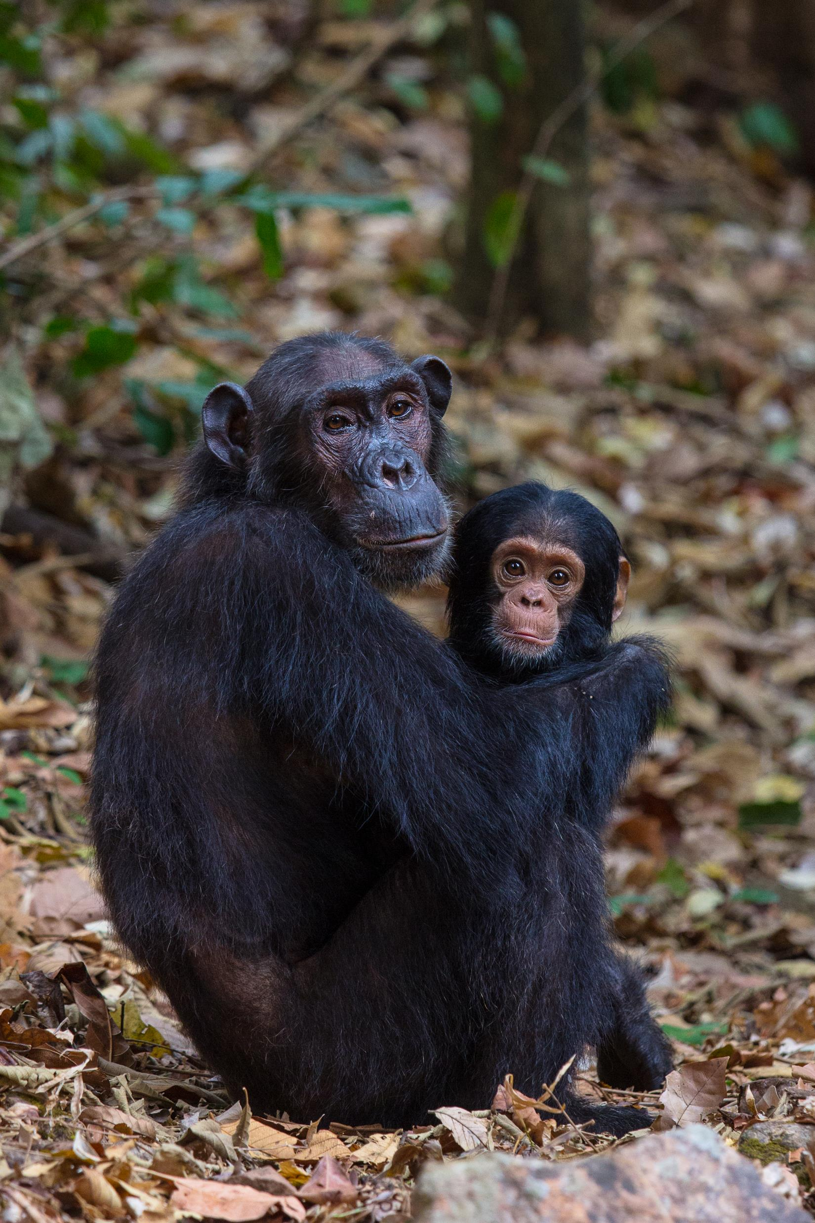
My background 30+ years
Conservation biology
Spatial ecology and remote sensing
Animal behavioral ecology
Stress physiology
Parasitology
Socioeconomics of natural resource use
Epidemiology and disease surveillance
Data science
Statistics

Slide 4
Your Teaching Assistants
Rupinder Kaur Bakhshi
Savannah Cooley

Slide 5
Course objectives

Slide 6
Objectives
Introduce data manipulation, visualization, and statistical modeling with an emphasis on applications in ecology and evolution
Become familiar with using the R programming language
Obtain a thorough grasp of the statistical workhorse of ecology and evolution: linear regression
Develop the conceptual basis for understanding many complex statistical methods as extensions of the basic linear regression strategy
Be able to read the ecology and evolution literature with a critical eye towards statistical procedures and interpretation

Slide 7
Objectives, cont.
This is NOT a traditional introduction to statistics class that teaches the same old concepts about null-hypothesis testing. These concepts are outdated and quickly changing. You will be part of that change.
Our goal is to give you the conceptual understanding of the basic building blocks of modern (!) statistics that you can build on and adapt to your needs.

Slide 8
Course logistics

Slide 9
Logistics
You will need your own computer or share with someone
This course is primarily managed through the course’s github page at https://github.com/steffenfoerster/stats_eco_evo_2021
Assignments will be submitted and graded on Canvas
Please read the syllabus for details related to expectations, assignments, grading, and class policies
Syllabus will be updated, please stay on top of all changes!
Use the discussion board on Canvas to ask questions about anything!

Slide 10
RStudio Cloud

Slide 11
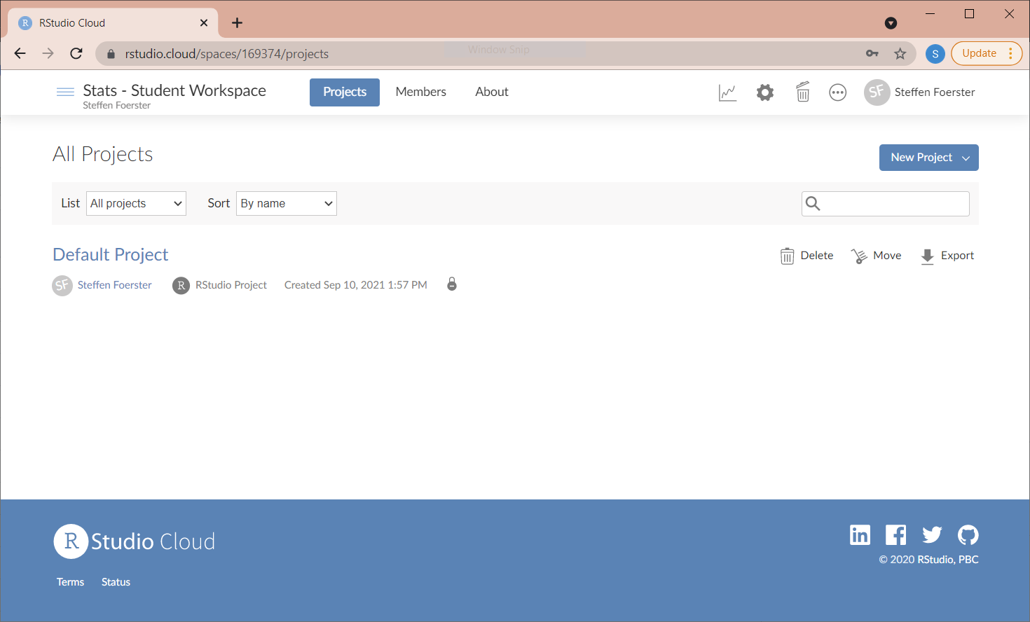

Slide 12
RStudio Cloud instructions
Go to www.rstudio.cloud
Open a free account
You will be invited to the “Stats – Student Workspace”
Copy the “Default Project” to your own workspace
You are all set!

Slide 13
RStudio
A brief introduction

Slide 14
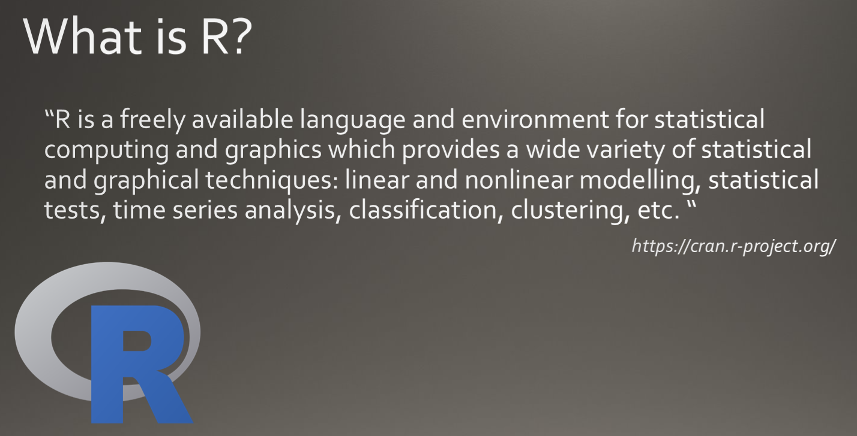

Slide 15
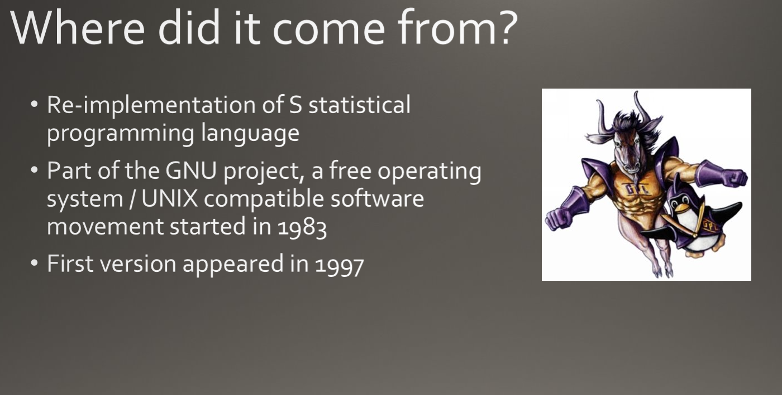

Slide 16
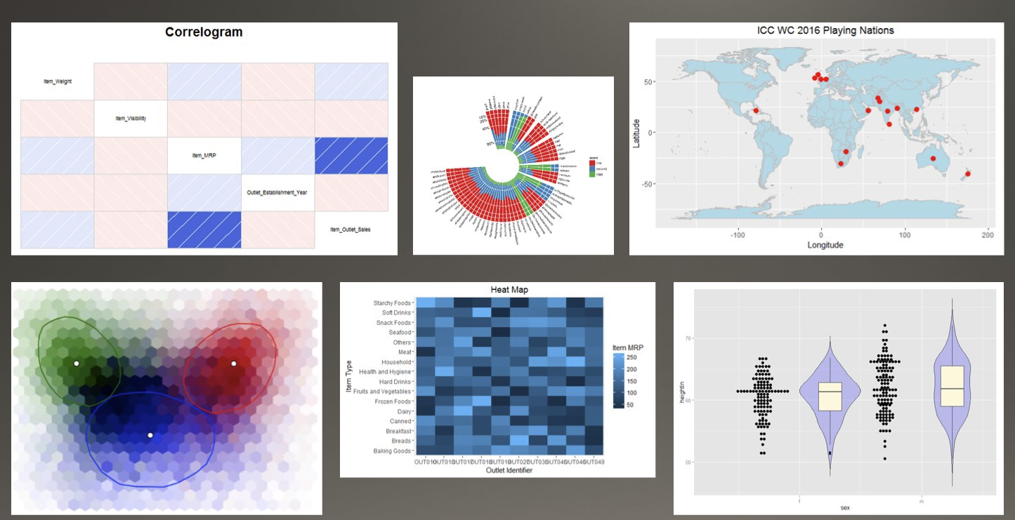

Slide 17
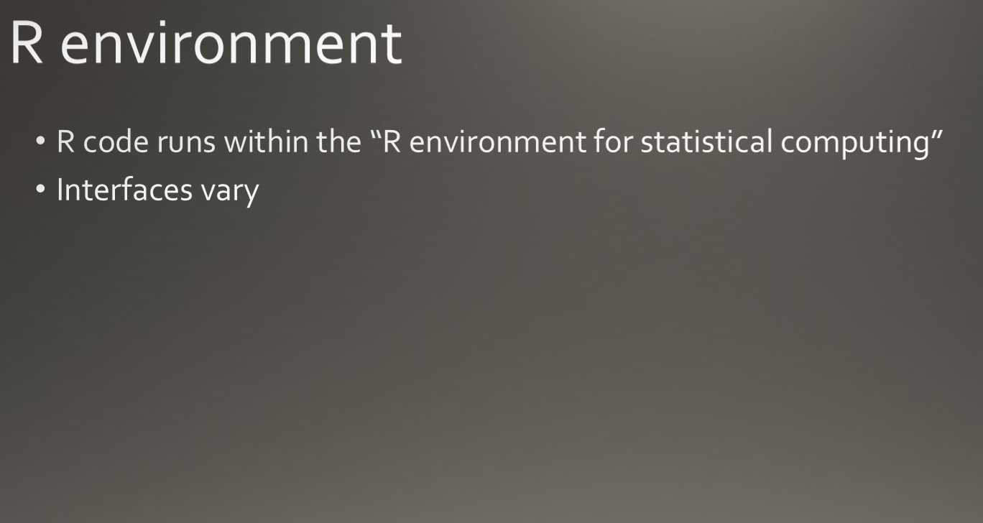

Slide 18
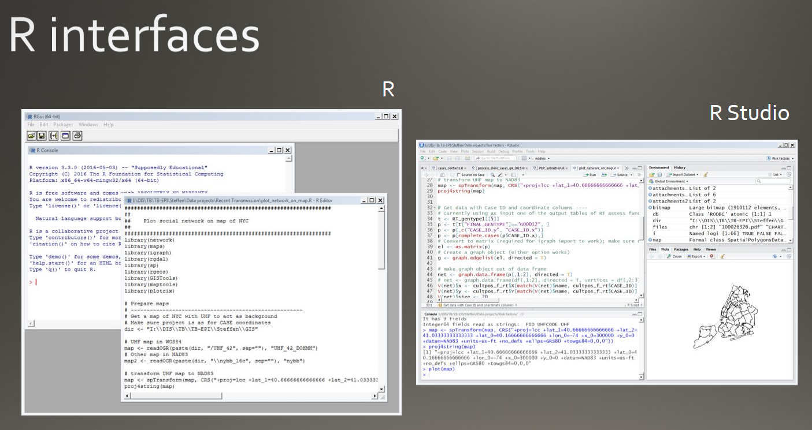

Slide 19
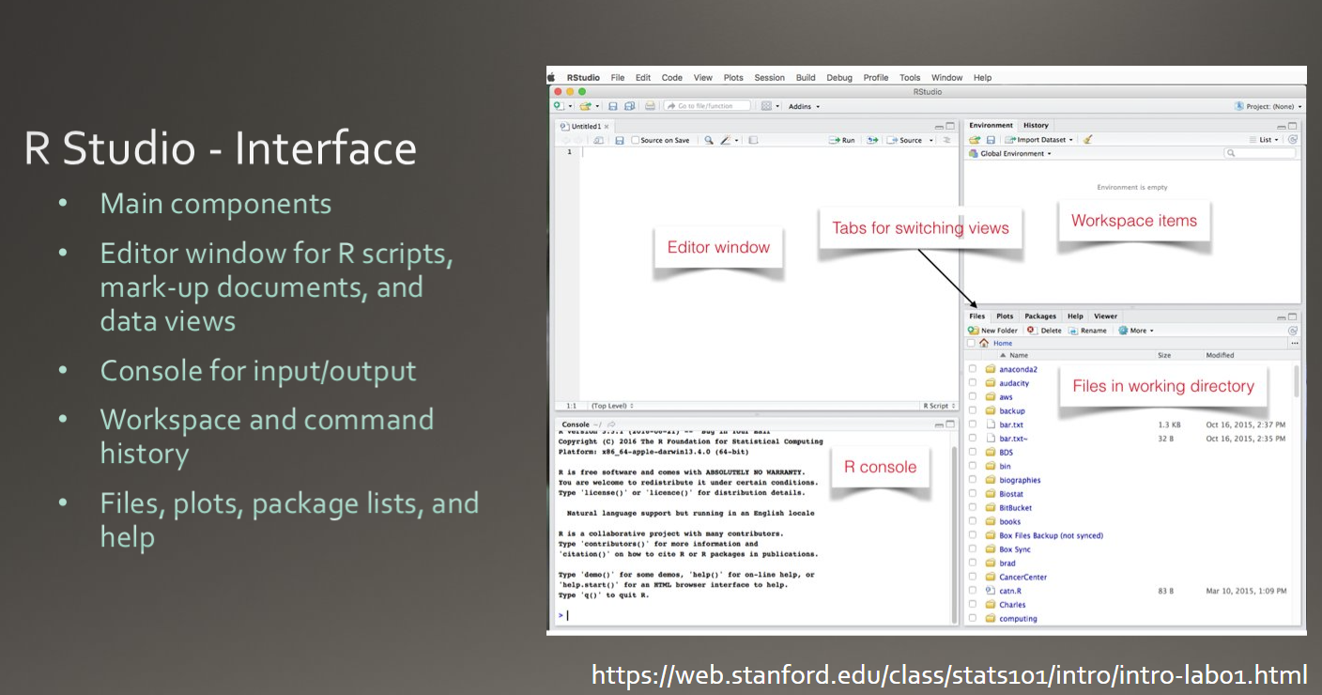

Slide 20
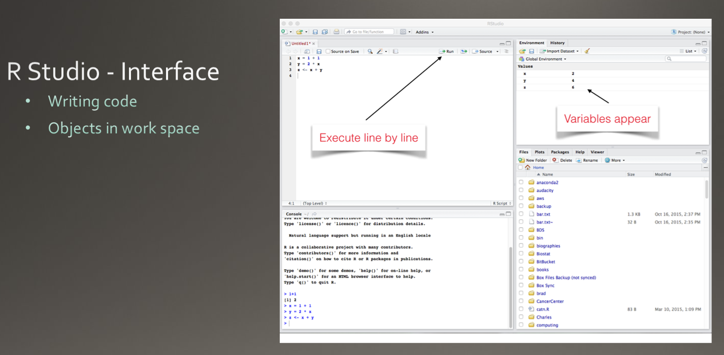

Slide 21
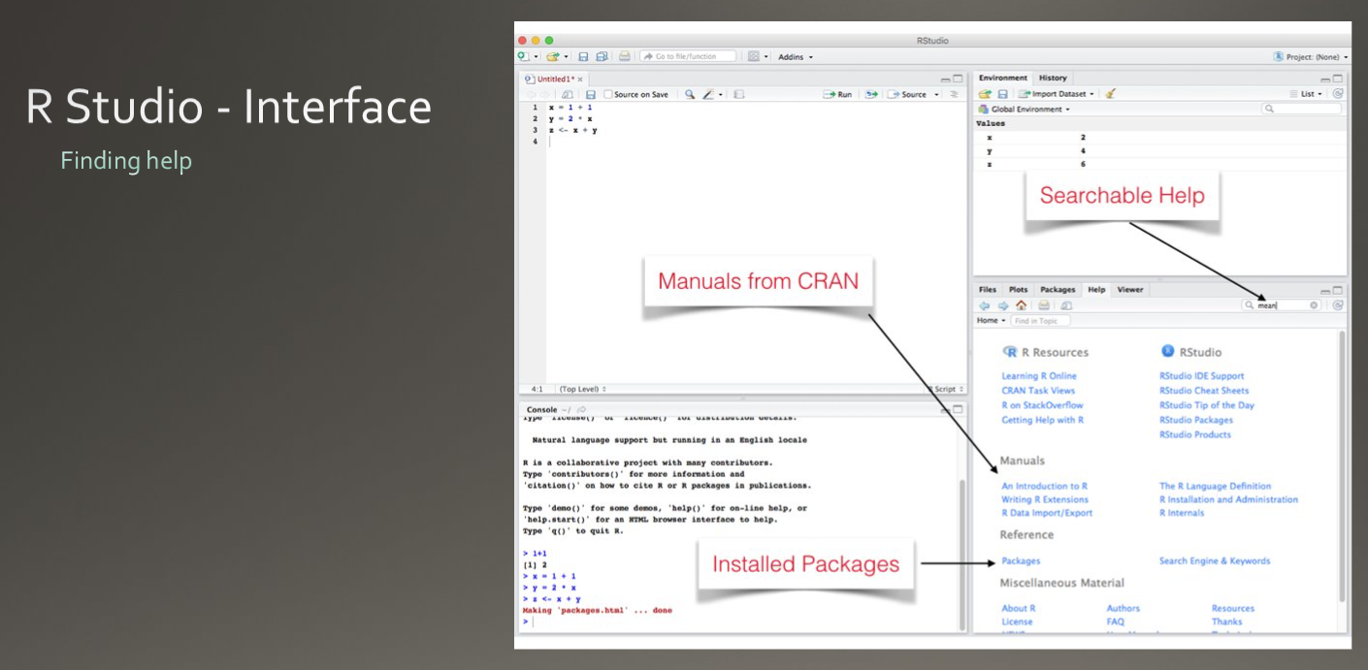

Slide 22
Demo and basic syntax
Let’s get our hands dirty!

